Slide 1
Span and Div
<span> and <div> are tags that let you select a group of elements and apply styles to them
<span> is an inline tag
  no breaks are added before or after <span></span>
<div> is a block tag
  a break is usually added by the browser before and after the <div></div> tags

Slide 2
Example of Span and Div
<html>
<head><title>Span and Div</title>
<style type=“text/css”>
.red {color:red; font-family: Georgia; font-weight:bold;}
</style>
</head><body>
<p>This will also appear as normal paragraph text except <span class=“red”>here because I made the text red,bold, and Georgia font without breaking up the paragraph.</span> Now I am back to normal... </p>
<p>
I start off as normal paragraph text here as well. However, when I use a div tag to apply a style, my paragraph is broken like <div class=“red”>this. You can see that the browser sets off this text from the text before and </div> after it. Now I am back to normal again.
</p>
</body></html>

Slide 3
Block Level Elements:
If no width is set, will expand naturally to fill its parent container.
Can have margins and/or padding
If no height is set, will expand naturally to fit its child elements (assuming they are not floated or positioned)
By default, will be placed below previous elements in the markup (assuming no floats or positioning on surrounding elements)

Slide 4
Inline Elements:
Flows along with text content, thus
Is subject to white-space settings in CSS
Will ignore top and bottom margin settings, but will apply left and right margins, and any padding
Will ignore the width and height properties

Slide 5
Block-level elements in HTML:
  Heading tags, e.g., <H1>, <H2>
  <p> , <pre>
  List tags, e.g., <ul>, <ol>, <dl>
  <div> , <body>
  <hr>, <img>
  <fieldset> , <form>
  <table>
  Inline Elements:
  b, big, i, small
  abbr, strong
  a, bdo, br, img, map, span, sub, sup
  button, input, label, select, textarea.

Slide 6
Formatting Width & Height of Block-Level Boxes
To set the width of a block-level element, use:
  width:value
  height:value
  where value can be a length value, a percentage, or auto
E.g., textarea {width:225px; height:100px}

Slide 7
BOX MODEL
In CSS, the term "box model" is used when talking about design and layout.
The CSS box model is essentially a box that wraps around HTML elements, and it consists of: margins, borders, padding, and the actual content.
The box model allows us to place a border around elements and space elements in relation to other elements.

Slide 8
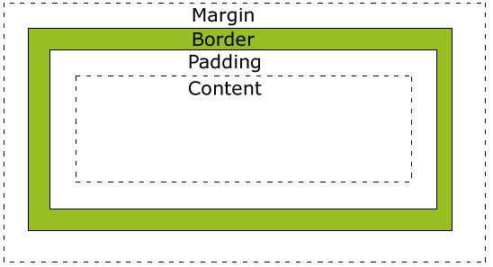
CSS Box Model
Every rendered element occupies a box:

Slide 9
Explanation of the different parts:
Margin - Clears an area around the border. The margin does not have a background color, it is completely transparent
Border - A border that goes around the padding and content. The border is inherited from the color property of the box
Padding - Clears an area around the content. The padding is affected by the background color of the box
Content - The content of the box, where text and images appear

Slide 10
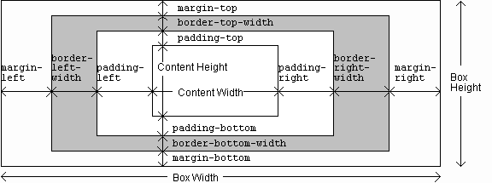
CSS Box Model
Guy-Vincent Jourdan :: CSI 3140 :: based on Jeffrey C. Jackson’s slides

Slide 11
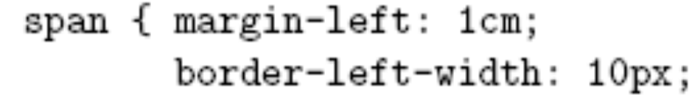
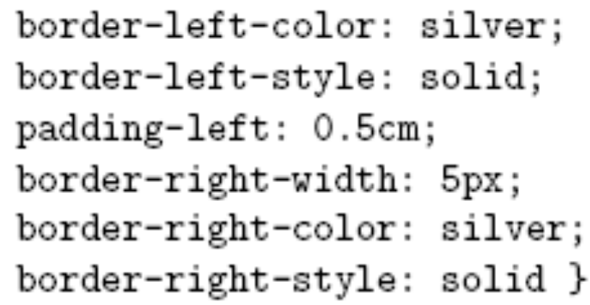
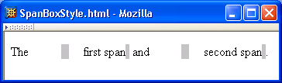
CSS Box Model
Guy-Vincent Jourdan :: CSI 3140 :: based on Jeffrey C. Jackson’s slides

Slide 12
Margins & Padding
Margins
Margins define the space around elements outside the border
Margin properties can have negative values in order to deliberately overlap content
Margin properties will affect the position of background elements (graphics and/or colours) in relation to the edges of the containing block element
Margin properties can be defined independently on top, right, bottom and left, or all-at-once using CSS shorthand
SM5312 week 9: CSS Layout

Slide 13
The margin property can have from one to four values.
margin:25px 50px 75px 100px;
  top margin is 25px
  right margin is 50px
  bottom margin is 75px
  left margin is 100px
margin:25px 50px 75px;
  top margin is 25px
  right and left margins are 50px
  bottom margin is 75px
margin:25px 50px;
  top and bottom margins are 25px
  right and left margins are 50px
margin:25px;
  all four margins are 25px

Slide 14
Margins & Padding
Padding
Padding defines the space around elements inside the border; i.e between the border and the content itself
Padding properties cannot have negative values
Padding properties do not affect the position of background elements (graphics and/or colours) in the containing block element; only the position of content.
Padding properties can be defined independently on top, right, bottom and left, or all-at-once using CSS shorthand
SM5312 week 9: CSS Layout

Slide 15
The padding property can have from one to four values.
padding:25px 50px 75px 100px;
  top padding is 25px
  right padding is 50px
  bottom padding is 75px
  left padding is 100px
padding:25px 50px 75px;
  top padding is 25px
  right and left paddings are 50px
  bottom padding is 75px
padding:25px 50px;
  top and bottom paddings are 25px
  right and left paddings are 50px
padding:25px;
  all four paddings are 25px

Slide 16
CSS Shorthand: Margin and Padding
You can also apply just one value, example:
#container {
padding: 20px;
margin: 5px;
}
Which will apply the value
specified equally on all 4 sides
5
20
5
Content Area
5
20
20
20
5
SM5312 week 9: CSS Layout

Slide 17
CSS Shorthand: Margin and Padding
And you can apply two values, example:
#container {
padding: 10px 20px;
margin: 0px 5px;
}
The first value is applied to
the top and bottom
The second value is applied to
the left and right
0
10
5
Content Area
5
20
20
10
0
SM5312 week 9: CSS Layout

Slide 18
Borders
Borders can be applied to any block element
Borders always come outside the padding area, but inside the margin area.
Border properties cannot have negative values
If a border is not specified, the default is no-border (i.e. no border appears and no space between any margin and padding is allocated for a border)
Border properties can be defined independently on top, right, bottom and left, or all-at-once using CSS shorthand
SM5312 week 9: CSS Layout

Slide 19
Borders
The core border properties are:
  Width: px, in, cm, or ‘thin’, ‘medium’, ‘thick’
  Style: dotted, dashed, solid, double, groove, ridge, inset, outset, hidden, etc
  Color: ‘blue’, ‘red’, #FF9900, etc
You can also create the effect of a border by using a graphic image in a CSS background property, instead of the border property
SM5312 week 9: CSS Layout

Slide 20
Border - Individual sides
In CSS it is possible to specify different borders for different sides:
p
{
border-top-style:dotted;
border-right-style:solid;
border-bottom-style:dotted;
border-left-style:solid;
}

Slide 21
The border-style property can have from one to four values.
border-style:dotted solid double dashed;
  top border is dotted
  right border is solid
  bottom border is double
  left border is dashed
border-style:dotted solid double;
  top border is dotted
  right and left borders are solid
  bottom border is double
border-style:dotted solid;
  top and bottom borders are dotted
  right and left borders are solid
border-style:dotted;
  all four borders are dotted

Slide 22
Property: Display
Display property will change your block level element to inline element and vice-versa.
Three values of display properties are:
  Block
  Inline
  None

Slide 23



Display Examples
Making a <span> behave like a <div>
Making a <div> behave like a <span>
Hiding any images of the class ‘hidden’

Slide 24
Using the Float and Clear property
To float (wrap) a block-level element, use:
  float:margin
  Where margin = right, left, none
To prevent an element from wrapping, use:
  Clear:margin
  Where margin=right, left, both, none
property | description
float | side to hover on; can be left, right, or none (default)
property | description
clear | disallows floating elements from overlapping this element; can be left, right, or none (default)

Slide 25
Float:
      Elements are floated horizontally, this means that an element can only be floated left or right, not up or down.
      A floated element will move as far to the left or right as it can. Usually this means all the way to the left or right of the containing element.
      The elements after the floating element will flow around it.
      The elements before the floating element will not be affected.
      Eg: If you place several floating elements after each other, they will float next to each other if there is room.
      Eg: Elements after the floating element will flow around it. To avoid this, use the clear property. The clear property specifies which sides of an element other floating elements are not allowed.

Slide 26
Using the Float Attribute
4 boxes float:right; width:50px; clear:right;
3 boxes
float:right;
width:50px;
4 boxes
float:right;
width:50px;

Slide 27
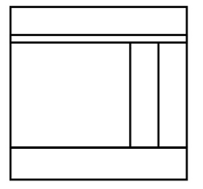
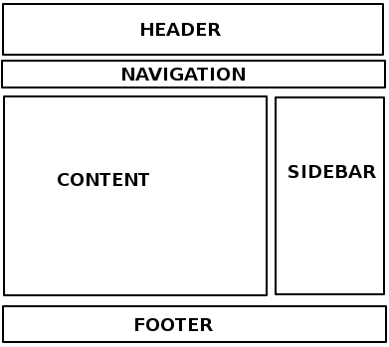
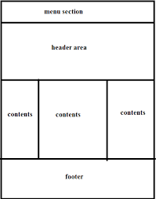
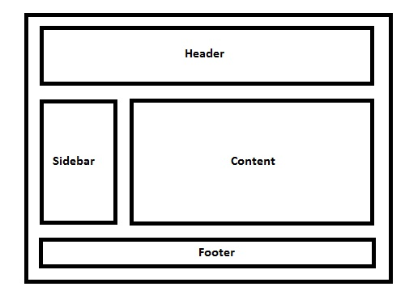
Different Layouts with float and clear

Slide 28
The overflow property (cont.)
property | description
overflow | specifies what to do if an element's content is too large; can be auto, visible, hidden, or scroll
CS380
Notes:
https://css-tricks.com/almanac/properties/o/overflow/

Slide 29
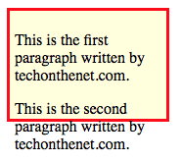
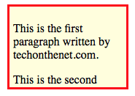
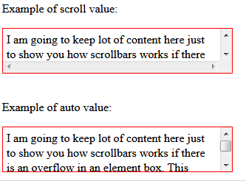
Values of overflow property
visible: content is not clipped when it proceeds outside its box. This is the default value of the property.
hidden: overflowing content will be hidden.
scroll: similar to hidden except users will be able to scroll through the hidden content.
auto: if the content proceeds outside its box then that content will be hidden whilst a scroll bar should be visible for users to read the rest of the content.
Example of visible and hidden value:
Notes:
https://css-tricks.com/almanac/properties/o/overflow/

Slide 30
The overflow property specifies what should happen if content overflows an element's box.
This property specifies whether to clip content or to add scrollbars when an element's content is too big to fit in a specified area.
Note: The overflow property only works for block elements with a specified height.

Slide 31
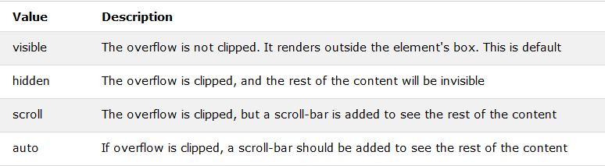

Slide 32
Positioning
The position property specifies the type of positioning method used for an element (static, relative, fixed or absolute).
There are four different position values:
  static
  relative
  fixed
  absolute

Slide 33
property | value | description
position | static | default position
 | relative | offset from its normal static position
 | absolute | a fixed position within its containing element
 | fixed | a fixed position within the browser window
top, bottom, left, right | positions of box's corners
Notes:
http://www.barelyfitz.com/screencast/html-training/css/positioning/

